Slide 1
Instructor: Amit Kumar Das
Lecture 9
Lecturer,
Department of Computer Science & Engineering,
East West University
Dhaka, Bangladesh.

Slide 2
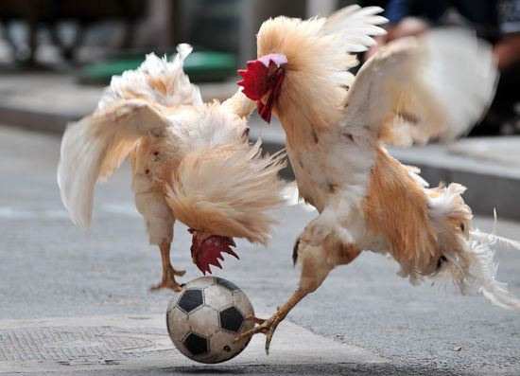
Game theory (Sections 17.5-17.6)

Slide 3
Game theory
Game theory deals with systems of interacting agents where the outcome for an agent depends on the actions of all the other agents
Applied in sociology, politics, economics, biology, and, of course, AI
Agent design: determining the best strategy for a rational agent in a given game
Mechanism design: how to set the rules of the game to ensure a desirable outcome

Slide 4

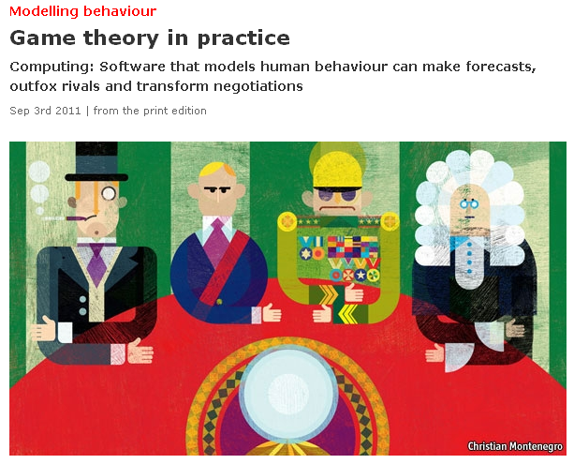
http://www.economist.com/node/21527025
Notes:
Applications: modeling auctions, negotiations, effect of regulatory schemes, military moves

Slide 5
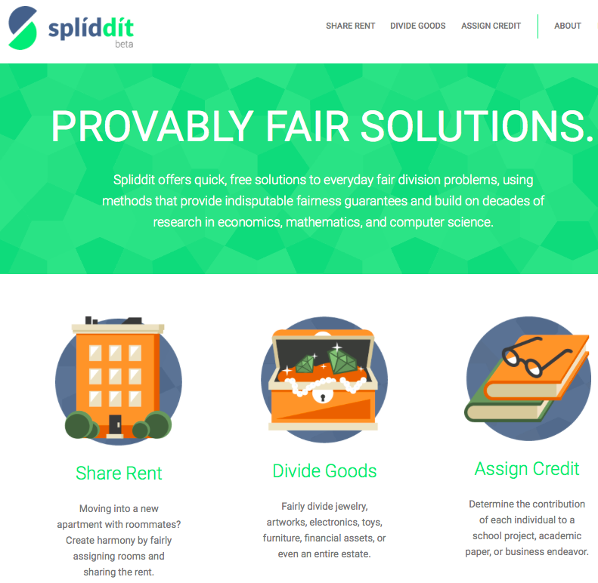
http://www.spliddit.org

Slide 6

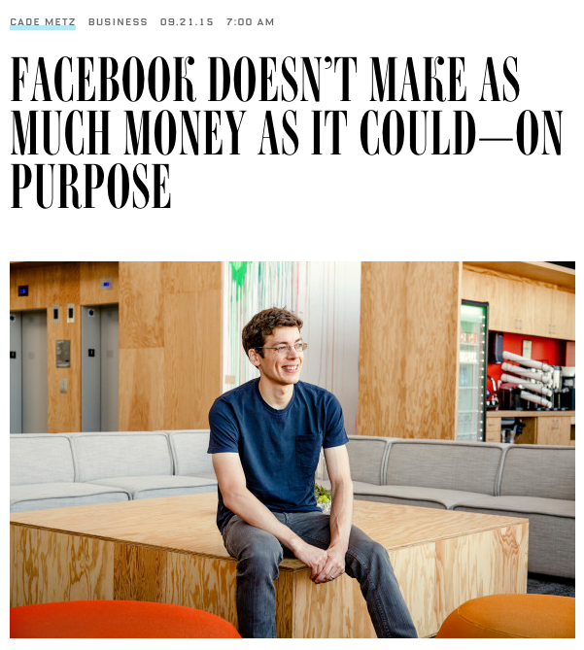
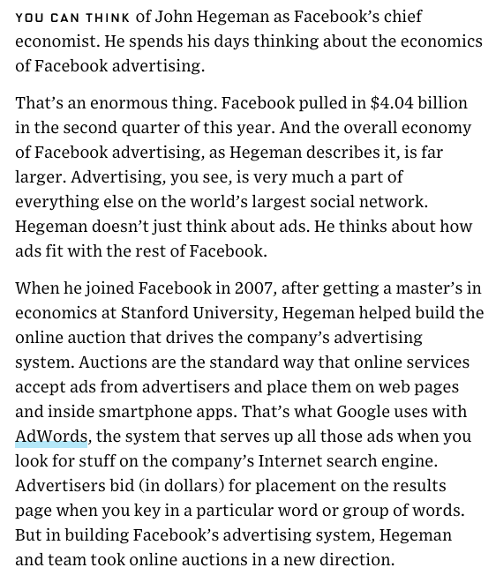
http://www.wired.com/2015/09/facebook-doesnt-make-much-money-couldon-purpose/

Slide 7
Prisoner’s dilemma
DEMO

Slide 8
Prisoner’s dilemma
Two criminals have been arrested and the police visit them separately
If one player testifies against the other and the other refuses, the one who testified goes free and the one who refused gets a 10-year sentence
If both players testify against each other, they each get a 5-year sentence
If both refuse to testify, they each get a 1-year sentence
 | Alice: Testify | Alice: Refuse
Bob: Testify | -5,-5 | -10,0
Bob: Refuse | 0,-10 | -1,-1

Slide 9
Prisoner’s dilemma
Alice’s reasoning:
Suppose Bob testifies. Then I get 5 years if I testify and 10 years if I refuse. So I should testify.
Suppose Bob refuses. Then I go free if I testify, and get 1 year if I refuse. So I should testify.
Dominant strategy: A strategy whose outcome is better for the player regardless of the strategy chosen by the other player
 | Alice: Testify | Alice: Refuse
Bob: Testify | -5,-5 | -10,0
Bob: Refuse | 0,-10 | -1,-1

Slide 10
Nash Equilibrium
“If there is a set of strategies with the property that no player can benefit by changing her strategy while the other players keep their strategies unchanged, then that set of strategies and the corresponding payoffs constitute the Nash Equilibrium. "

Slide 11
Prisoner’s dilemma
Nash equilibrium: A pair of strategies such that no player can get a bigger payoff by switching strategies, provided the other player sticks with the same strategy
(Testify, testify) is a dominant strategy equilibrium
Pareto optimal outcome: It is impossible to make one of the players better off without making another one worse off
In a non-zero-sum game, a Nash equilibrium is not necessarily Pareto optimal!
 | Alice: Testify | Alice: Refuse
Bob: Testify | -5,-5 | -10,0
Bob: Refuse | 0,-10 | -1,-1

Slide 12
Prisoner’s dilemma in real life
 | Defect | Cooperate
Defect | Lose – lose | Lose big – win big
Cooperate | Win big – lose big | Win – win
Price war
Arms race
Steroid use
Diner’s dilemma
Collective action in politics
http://en.wikipedia.org/wiki/Prisoner’s_dilemma
Notes:
Diner’s dilemma [Wikipedia]: several individuals go out to eat, and prior to ordering they agree to split the check equally between all of them. Each individual must now choose whether to order the expensive or inexpensive dish. It is presupposed that the expensive dish is better than the cheaper, but not by enough to warrant paying the difference compared to eating alone. Each individual reasons that the expense they add to their bill by ordering the more expensive item is very small, and thus the improved dining experience is worth the money. However, every individual reasons this way and they all end up paying for the cost of the more expensive meal, which, by assumption, is worse for everyone than ordering and paying for the cheaper meal.

Slide 13
Valentine’s Day Problem
Suppose my wife and I have both lost our cell phones and cannot contact each other. Both of us would really like to spend more time at home with each other (utility 3) in the valentine’s day. But both of us also have a slight preference in favor of working late and earning some overtime (utility 2). If I go home and my wife's there and I can spend time with her, great. If I stay at work and make some money, that would be pretty okay too. But if I go home and my wife's not there and I have to sit around alone all night, that would be the worst possible outcome (utility 1). Meanwhile, my wife has the same set of preferences: she wants to spend time with me, she'd be okay with working late, but she doesn't want to sit at home alone.
Notes:
Diner’s dilemma [Wikipedia]: several individuals go out to eat, and prior to ordering they agree to split the check equally between all of them. Each individual must now choose whether to order the expensive or inexpensive dish. It is presupposed that the expensive dish is better than the cheaper, but not by enough to warrant paying the difference compared to eating alone. Each individual reasons that the expense they add to their bill by ordering the more expensive item is very small, and thus the improved dining experience is worth the money. However, every individual reasons this way and they all end up paying for the cost of the more expensive meal, which, by assumption, is worse for everyone than ordering and paying for the cheaper meal.

Slide 14
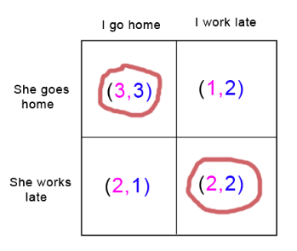
Notes:
Diner’s dilemma [Wikipedia]: several individuals go out to eat, and prior to ordering they agree to split the check equally between all of them. Each individual must now choose whether to order the expensive or inexpensive dish. It is presupposed that the expensive dish is better than the cheaper, but not by enough to warrant paying the difference compared to eating alone. Each individual reasons that the expense they add to their bill by ordering the more expensive item is very small, and thus the improved dining experience is worth the money. However, every individual reasons this way and they all end up paying for the cost of the more expensive meal, which, by assumption, is worse for everyone than ordering and paying for the cheaper meal.

Slide 15
Is there any way to get a better answer?
Superrationality
Assume that the answer to a symmetric problem will be the same for both players
Maximize the payoff to each player while considering only identical strategies
Not a conventional model in game theory
Repeated games
If the number of rounds is fixed and known in advance, the equilibrium strategy is still to defect
If the number of rounds is unknown, cooperation may become an equilibrium strategy

Slide 16
Review: Game theory
Agent design and mechanism design
Dominant strategies
Nash equilibria
Pareto optimality
Examples of games

Slide 17

Game of Chicken
Player 1
Player 2
 | S | C
S | -10, -10 | -1, 1
C | 1, -1 | 0, 0
Chicken
Straight
Chicken
Straight
Is there a dominant strategy for either player?
Is there a Nash equilibrium?
(Straight, chicken) or (chicken, straight)
Anti-coordination game: it is mutually beneficial for the two players to choose different strategies
Model of escalated conflict in humans and animals (hawk-dove game)
How are the players to decide what to do?
Pre-commitment or threats
Different roles: the “hawk” is the territory owner and the “dove” is the intruder, or vice versa
http://en.wikipedia.org/wiki/Game_of_chicken

Slide 18
Mixed strategy equilibria
Player 1
Player 2
 | S | C
S | -10, -10 | -1, 1
C | 1, -1 | 0, 0
Chicken
Straight
Chicken
Straight
Mixed strategy: a player chooses between the moves according to a probability distribution
Suppose each player chooses S with probability 1/10. Is that a Nash equilibrium?
Consider payoffs to P1 while keeping P2’s strategy fixed
The payoff of P1 choosing S is (1/10)(–10) + (9/10)1 = –1/10
The payoff of P1 choosing C is (1/10)(–1) + (9/10)0 = –1/10
Can P1 change their strategy to get a better payoff?
Same reasoning applies to P2

Slide 19
Finding mixed strategy equilibria
 | P1: Choose S with prob. p | P1: Choose C with prob. 1-p
P2: Choose S with prob. q | -10, -10 | -1, 1
P2: Choose C with prob. 1-q | 1, -1 | 0, 0
Expected payoffs for P1 given P2’s strategy:
P1 chooses S: q(–10) +(1–q)1 = –11q + 1
P1 chooses C: q(–1) + (1–q)0 = –q
In order for P2’s strategy to be part of a Nash equilibrium, P1 has to be indifferent between its two actions:
–11q + 1 = –q or q = 1/10
Similarly, p = 1/10

Slide 20
Existence of Nash equilibria
Any game with a finite set of actions has at least one Nash equilibrium (which may be a mixed-strategy equilibrium)
If a player has a dominant strategy, there exists a Nash equilibrium in which the player plays that strategy and the other player plays the best response to that strategy
If both players have strictly dominant strategies, there exists a Nash equilibrium in which they play those strategies

Slide 21
Computing Nash equilibria
For a two-player zero-sum game, simple linear programming problem
For non-zero-sum games, the algorithm has worst-case running time that is exponential in the number of actions
For more than two players, and for sequential games, things get pretty hairy

Slide 22
Mechanism design (inverse game theory)
Assuming that agents pick rational strategies, how should we design the game to achieve a socially desirable outcome?
We have multiple agents and a center that collects their choices and determines the outcome

Slide 23
Auctions
Goals
Maximize revenue to the seller
Efficiency: make sure the buyer who values the goods the most gets them
Minimize transaction costs for buyer and sellers

Slide 24
Ascending-bid auction
What’s the optimal strategy for a buyer?
Bid until the current bid value exceeds your private value
Usually revenue-maximizing and efficient, unless the reserve price is set too low or too high
Disadvantages
Collusion
Lack of competition
Has high communication costs

Slide 25
Sealed-bid auction
Each buyer makes a single bid and communicates it to the auctioneer, but not to the other bidders
Simpler communication
More complicated decision-making: the strategy of a buyer depends on what they believe about the other buyers
Not necessarily efficient
Sealed-bid second-price auction: the winner pays the price of the second-highest bid
Let V be your private value and B be the highest bid by any other buyer
If V > B, your optimal strategy is to bid above B – in particular, bid V
If V < B, your optimal strategy is to bid below B – in particular, bid V
Therefore, your dominant strategy is to bid V
This is a truth revealing mechanism

Slide 26
Dollar auction
A dollar bill is auctioned off to the highest bidder, but the second-highest bidder has to pay the amount of his last bid
Player 1 bids 1 cent
Player 2 bids 2 cents
…
Player 2 bids 98 cents
Player 1 bids 99 cents
If Player 2 passes, he loses 98 cents, if he bids $1, he might still come out even
So Player 2 bids $1
Now, if Player 1 passes, he loses 99 cents, if he bids $1.01, he only loses 1 cent
…
What went wrong?
When figuring out the expected utility of a bid, a rational player should take into account the future course of the game
What if Player 1 starts by bidding 99 cents?

Slide 27
Dollar auction
A dollar bill is auctioned off to the highest bidder, but the second-highest bidder has to pay the amount of his last bid
Dramatization: https://www.youtube.com/watch?v=pA-SNscNADk

Slide 28
Regulatory mechanism design: Tragedy of the commons
States want to set their policies for controlling emissions
Each state can reduce their emissions at a cost of -10 or continue to pollute at a cost of -5
If a state decides to pollute, -1 is added to the utility of every other state
What is the dominant strategy for each state?
Continue to pollute
Each state incurs cost of -5-49 = -54
If they all decided to deal with emissions, they would incur a cost of only -10 each
Mechanism for fixing the problem:
Tax each state by the total amount by which they reduce the global utility (externality cost)
This way, continuing to pollute would now cost -54

Slide 29
Review: Game theory
Normal form representation of a game
Dominant strategies
Nash equilibria
Pareto optimal outcomes
Pure strategies and mixed strategies
Examples of games
Mechanism design
Auctions: ascending bid, sealed bid, sealed bid second-price, “dollar auction”

Slide 30
Thank You

